Slide 1


جامعة بنهـــــا
كلية الحاسبات والذكاء الاصطناعي
Orthopedic classification.
Machine Learning Project.
Team members:
Sherif Ashraf Ahmed Roshdy.
Abdelrahman Mohamed Khalil. Mohamed Hosny Mosad.
Yahia Zakria Ebrahim. Sobeh Salah Sobeh.

Slide 2
Introduction.
Domain of problem.
Software Details and Project Objective.
Dataset.
CONTENTS
Information about dataset.
Exploratory Dataset.
The Algorithms used to classification
Data preprocessing for machine learning.
KNN, Naive Bayes classifiers, Decision tree classifier.
Conclusion.
Compare with accurse of each model.
the decision of solving problem.

Slide 3
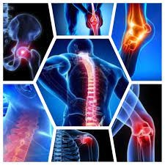
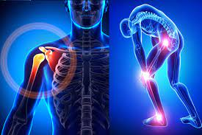
Introduction
Domain of problem.
Orthopedic relating to the branch of medicine dealing with the correction of deformities of bones or muscles.
medical information
3

Slide 4
Introduction
Conn.
If you suffer from pain in the bones, the bone examination will show whether this pain is normal or abnormal.
This is important because, in the event of abnormal pain, you will have to go to a specialist. After all, it may be very dangerous, such as Joints Dislocation or Fractures.
Bone, normal or abnormal, is an important tool for detecting cancer spread in the bones from the site of the original tumor, such as breast or prostate cancer,
It helps in repairing and preventing deformities in children at an early stage, and these deformities result from some factors that may affect the body while it is still at the embryo stage.
4

Slide 5
Introduction
Software Details and Project Objective.
Software Details:
Python (libraries) >> Pandas, SKLearn, Seaborn, Matplotlib, numpy.
Dataset >> Kaggle.
Project Objective
Used machine learning algorithms to classify a patient’s condition as normal or abnormal based on various orthopedic parameters
5

Slide 6
Dataset.
Biomechanical features of orthopedic patients | Kaggle

Slide 7
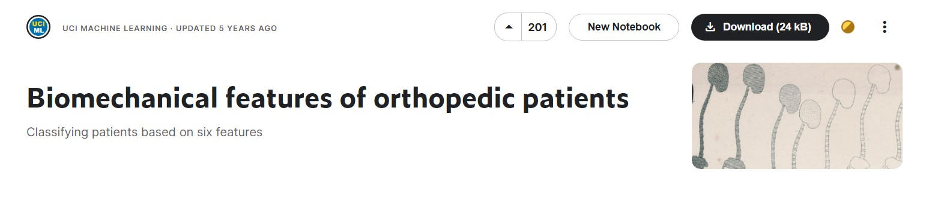
Dataset.
Information about dataset
Biomechanical features of orthopedic patients
Kaggle image.
7

Slide 8
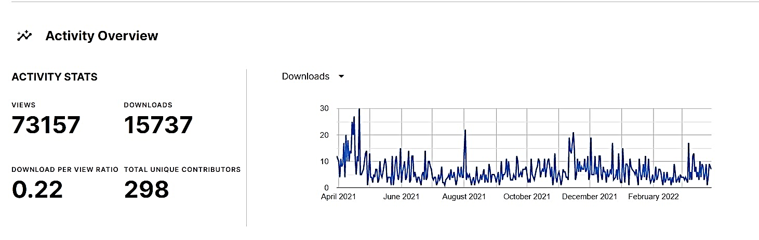
Dataset.
Conn.
The task consists in classifying patients as belonging to one out of two categories: Normal or Abnormal.
Activity Overview of dataset
8

Slide 9
Dataset.
Conn.
Each patient is represented in the data set by six biomechanical attributes derived from the shape and orientation of the pelvis and lumbar spine (each one is a column)
Pelvic incidence حدوث الحوض
pelvic tilt إمالة الحوض
lumbar lordosis angle زاوية قعس قطني
sacral slope منحدر عجزي
pelvic radius نصف قطر الحوض
grade of spondylolisthesis درجة انزلاق الفقار
9

Slide 10
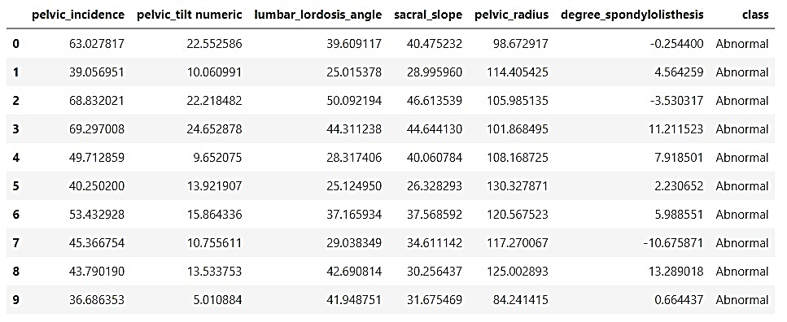
Dataset.
Exploratory Dataset.
Show the first 10 rows.
10

Slide 11
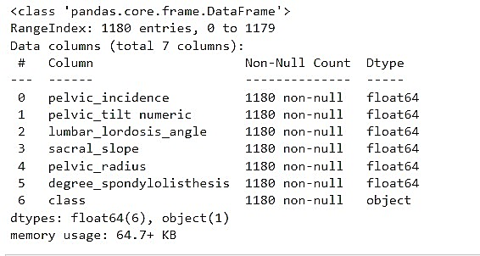
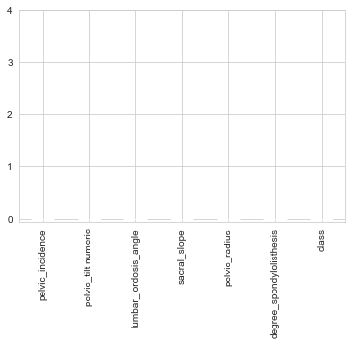
Dataset.
Conn.
Print a concise summary of a DataFrame.
The shape >> (1180,7)
Check the non-null values
11

Slide 12
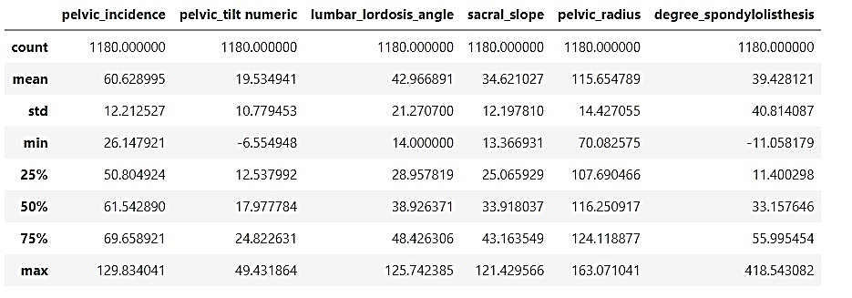
Dataset.
Conn.
Show descriptive statistics include those that summarize the central tendency, dispersion and shape of a dataset's distribution.
12

Slide 13
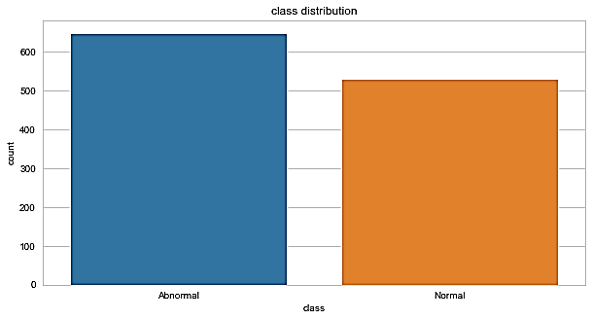
Dataset.
Conn.
Represent the number of output:
Normal (649 patients) or Abnormal (513 patients).
Checking for imbalanced output
13

Slide 14
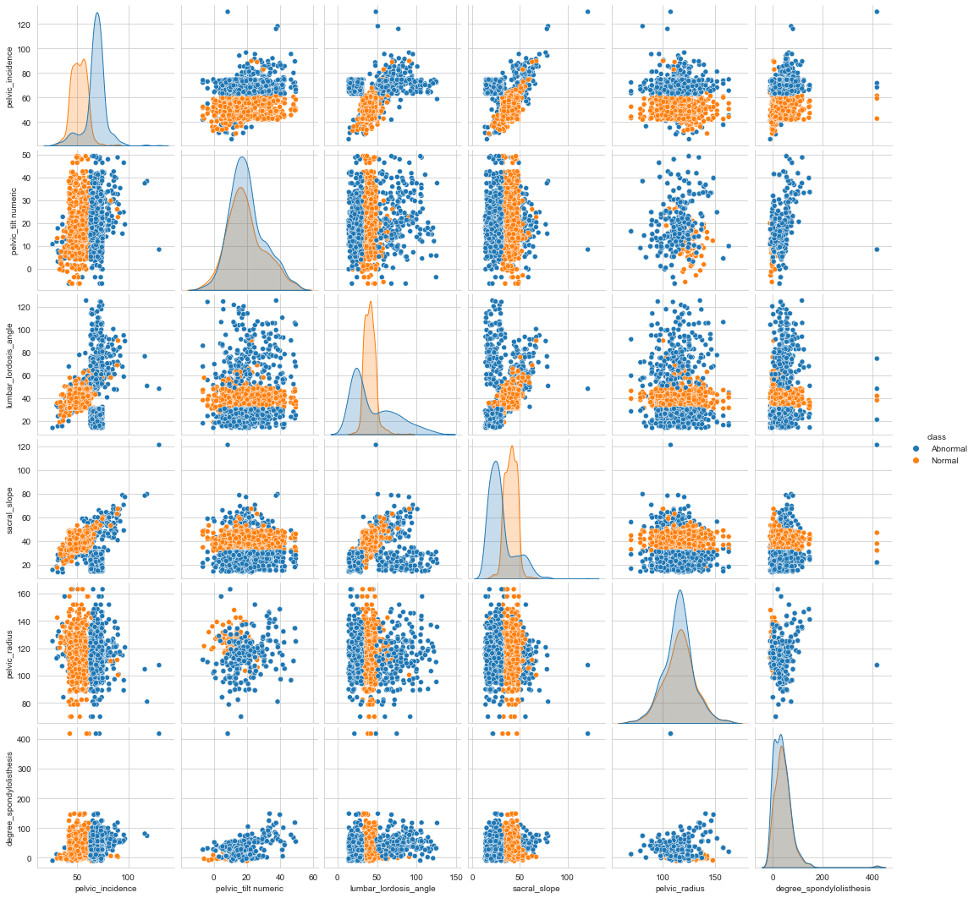
Dataset.
Conn.
Plot pairwise relationships in a dataset using seaborn.pairplot function.
14

Slide 15
Dataset.
Conn.
FacetGrid class helps in visualizing distribution of one variable as well as the relationship between multiple variables separately within subsets of your dataset using multiple panels.
15

Slide 16
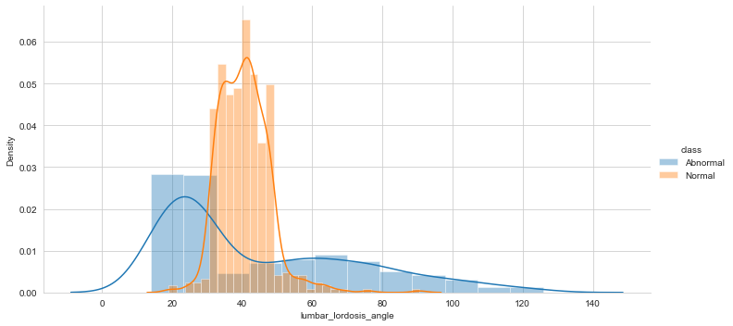
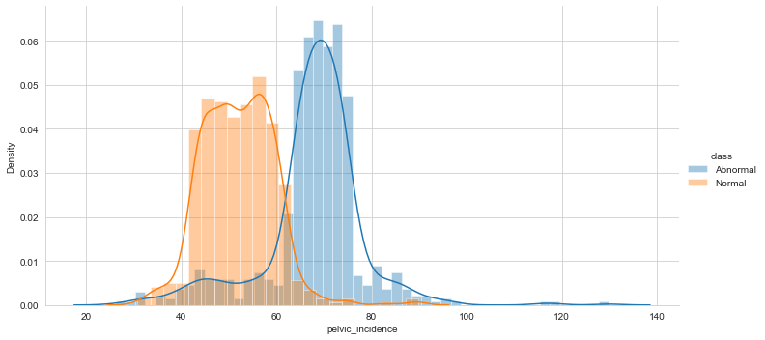
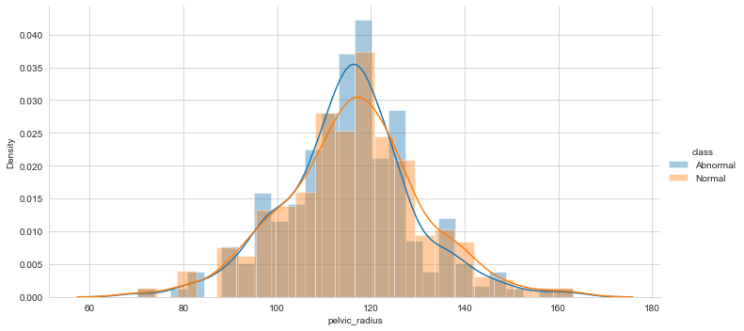
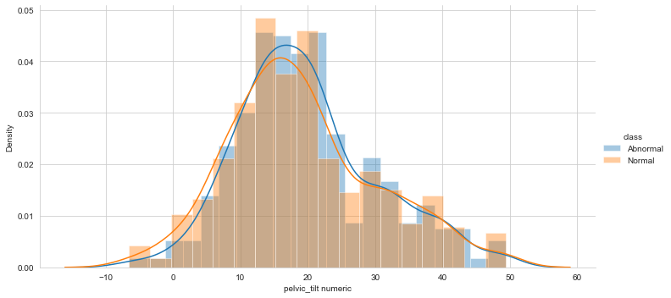
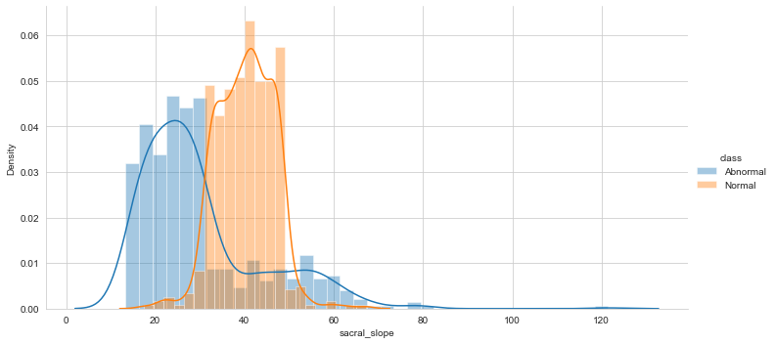
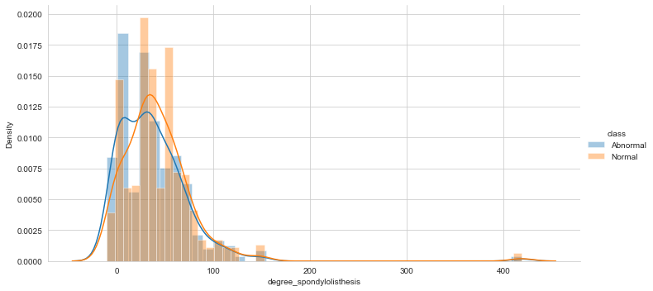

Slide 17
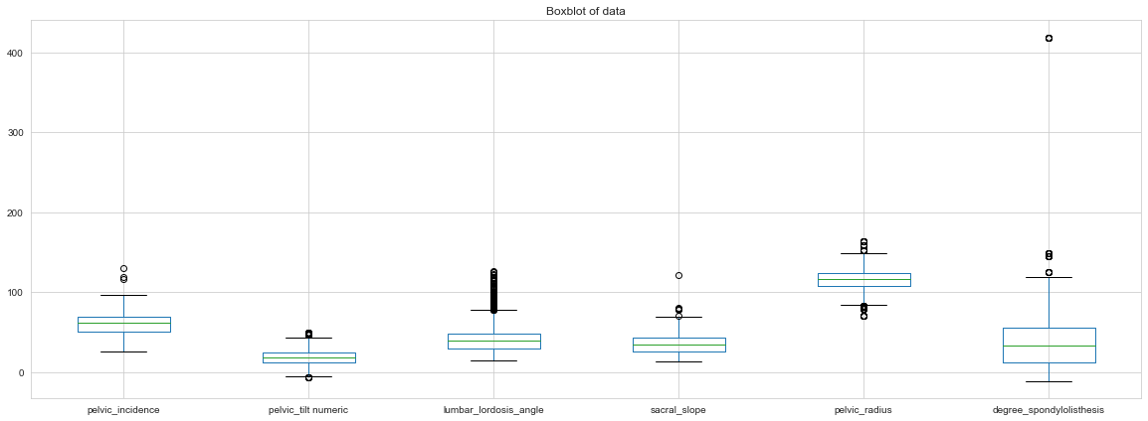
Dataset.
Conn.
Box plots are used to show distributions of numeric data values.
17

Slide 18
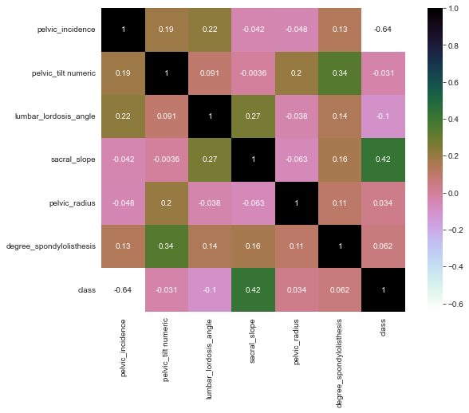
Dataset.
Conn.
Representing the correlation between features and some of them using heatmap function
18

Slide 19
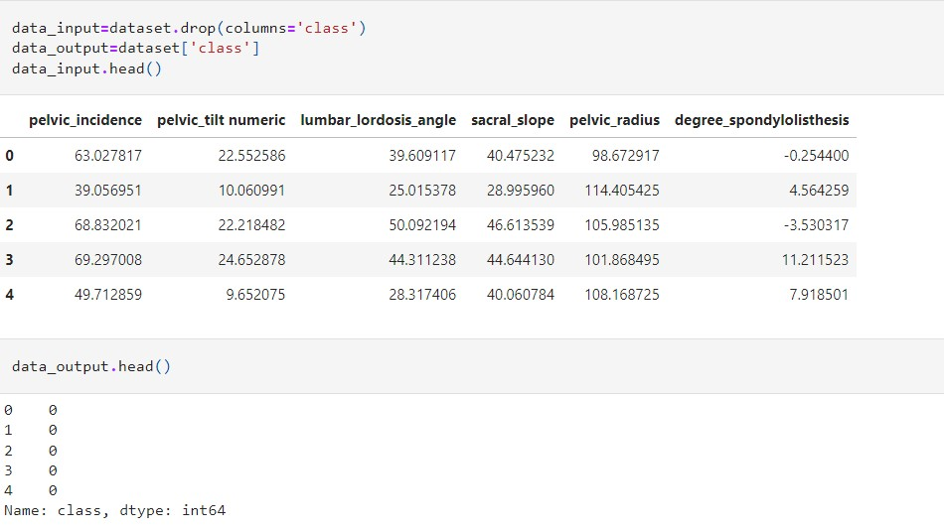

Data preprocessing for machine learning
Splitting dataset
Input data.
Output data
19

Slide 20
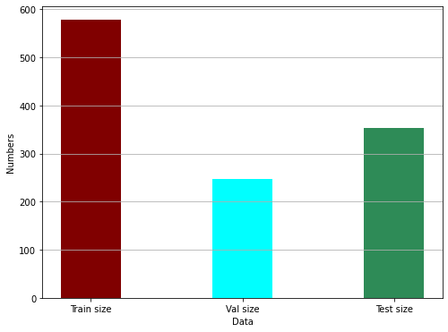
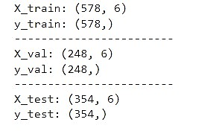
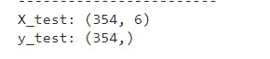
Data preprocessing for machine learning
Splitting Datasets
We need to split our dataset to 3 sets: Training, Validation, and Test data subsets.
20

Slide 21
The Algorithms used to classification
(KNN, Naive Bayes, Decision Tree )

Slide 22
The Algorithms used to classification
Hyper-parameter tuning
When we build a machine learning model ,we have a number of Hyper-parameters that will determine how our model looks like.
Changing the values of these variables will affect the accuracy of our model.
We need to find the best hyper-parameters for our model to achieve the best accuracy.
22

Slide 23
KNN Algorithm.

Slide 24
The Algorithms used to classification
KNN Algorithm.
the number of neighbors
Hyper-parameter in KNN
The weights
24

Slide 25
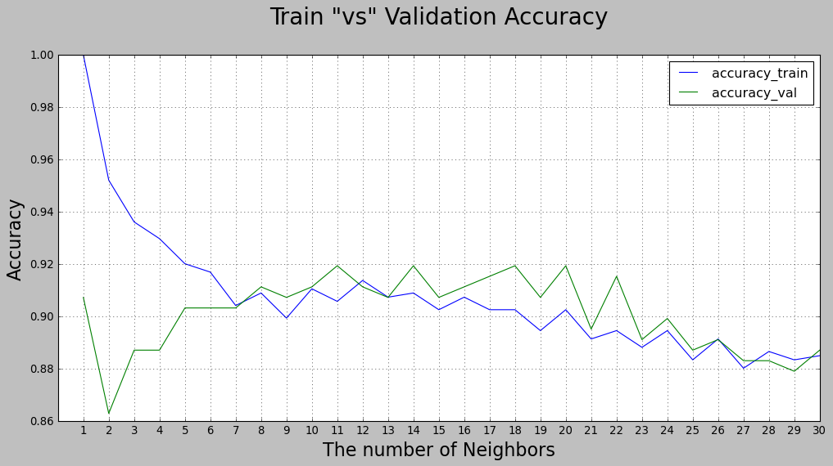
The Algorithms used to classification
KNN Algorithm.
The best k
25

Slide 26
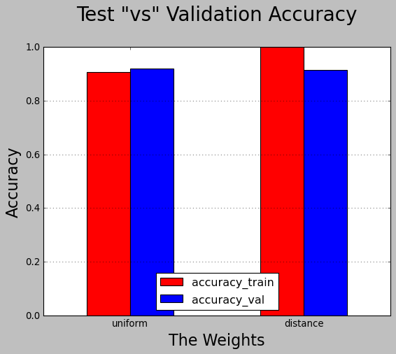
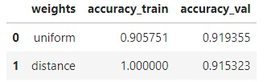
The Algorithms used to classification
KNN Algorithm.
The best weights
26

Slide 27
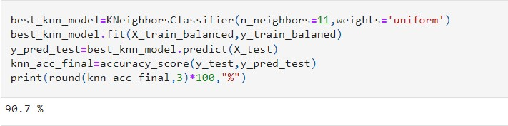
The Algorithms used to classification
KNN Algorithm.
Then we applied the KNeighborsClassifier using the best K (11) ,weight=“uniform”
27

Slide 28
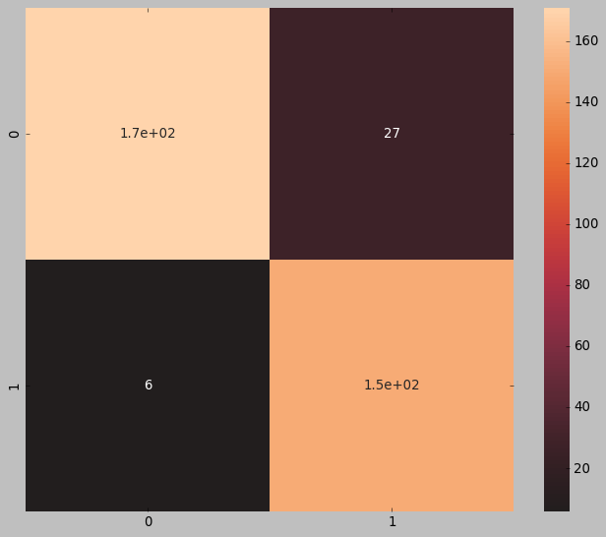
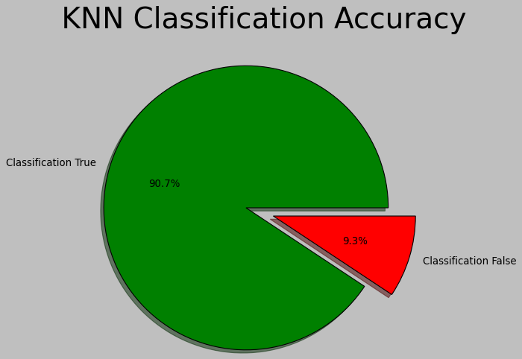
The Algorithms used to classification
KNN Algorithm.
plotted the confusion matrix
of KNN
KNN Accuracy = 91%
28

Slide 29
Naive Bayes Algorithm.

Slide 30
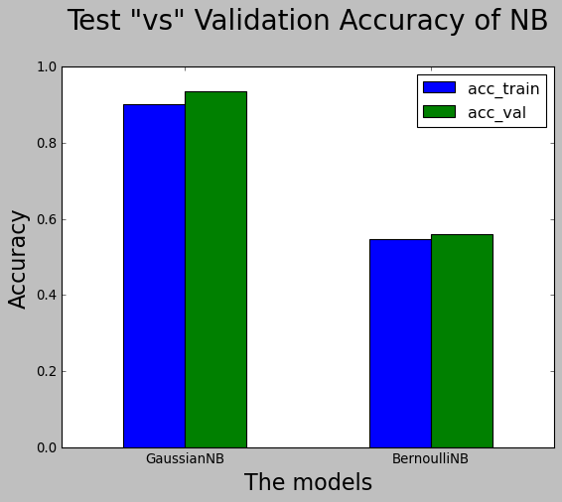
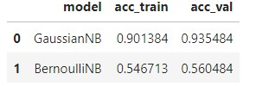
The Algorithms used to classification
Naive Bayes Algorithm.
GaussianNB model win
30

Slide 31
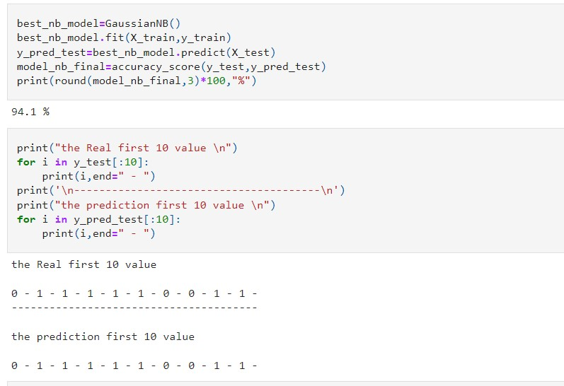
The Algorithms used to classification
Naive Bayes Algorithm.
We applied GaussianNB() in the data
31

Slide 32
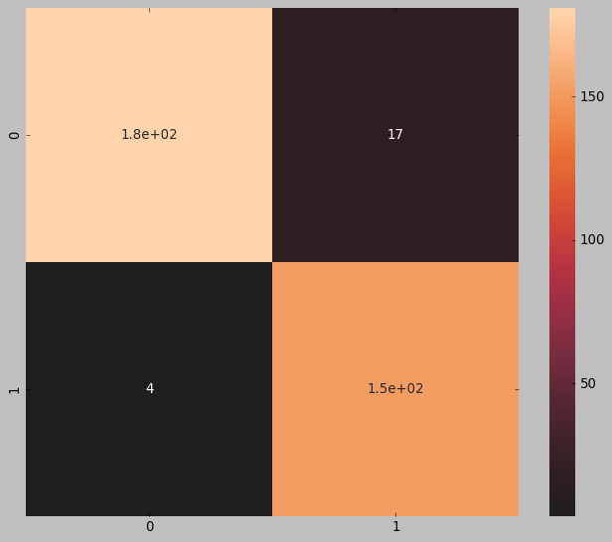
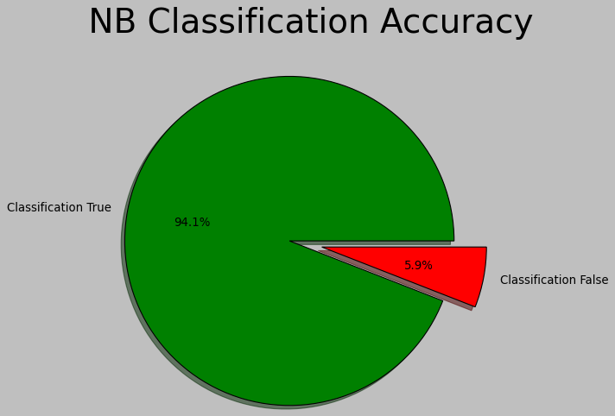
The Algorithms used to classification
Naive Bayes Algorithm.
plotted the confusion matrix
of NB
NB Accuracy = 94%
32

Slide 33
Decision Tree Algorithm

Slide 34
The Algorithms used to classification
DT Algorithm.
The max depth of tree
Hyper-parameter in DT
The Criterion
34

Slide 35
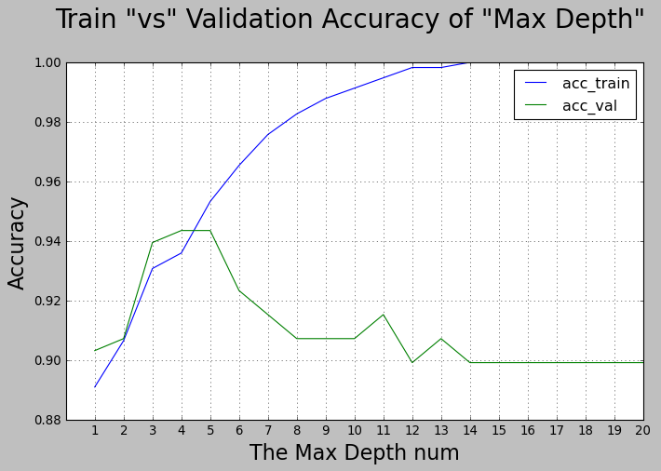
The Algorithms used to classification
Decision Tree Algorithm
The best max depth =4
35

Slide 36
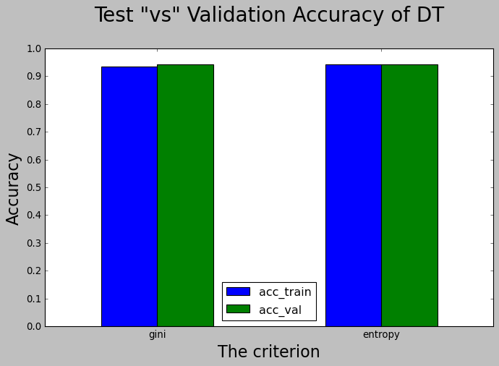
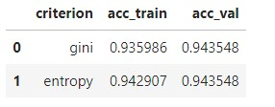
The Algorithms used to classification
Decision Tree Algorithm
36

Slide 37
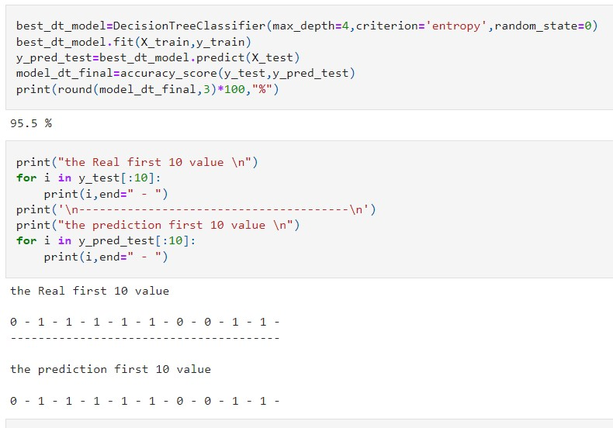
The Algorithms used to classification
Decision Tree Algorithm
We applied the DecisionTreeClassifier with max depth=4, criterion=“entropy”
37

Slide 38
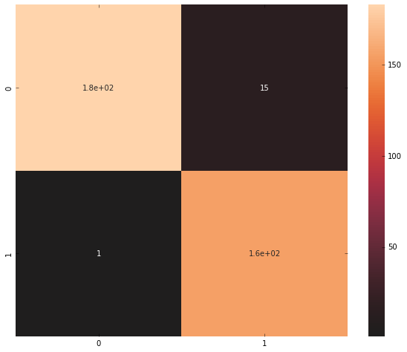

The Algorithms used to classification
Decision Tree Algorithm
plotted the confusion matrix
of DT
DT Accuracy = 95.5%
38

Slide 39
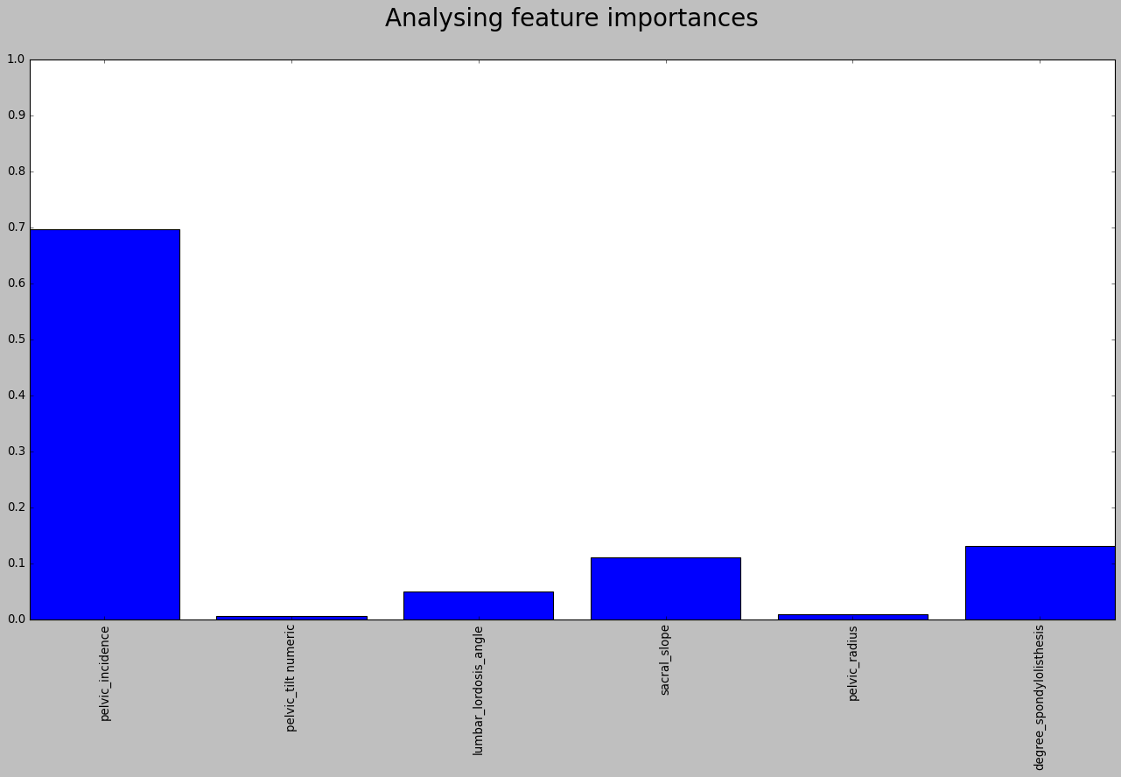
The Algorithms used to classification
Decision Tree Algorithm
39

Slide 40
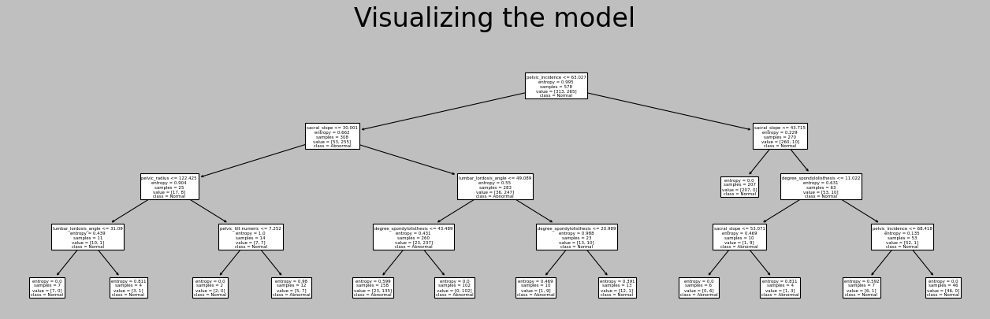
The Algorithms used to classification
Decision Tree Algorithm
40

Slide 41
Conclusion.

Slide 42
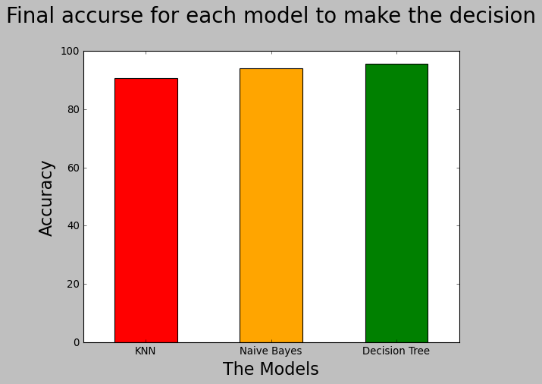
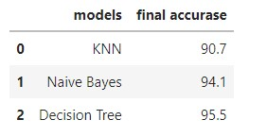
Conclusion.
Compare The Accuracy Of Each Model
42

Slide 43
Conclusion.
The Decision of solving problem.
When a new orthopedic patient comes to the hospital, we will be able to largely classify if he is normal or abnormal by adding some new biomechanical features to the model.
We can conclude that "Decision Tree Algorithm" works well for data because it has a high accuracy of 95.5%.
43

Slide 44
♥♥ THANK YOU! ♥♥
Any Questions?

